Slide 1
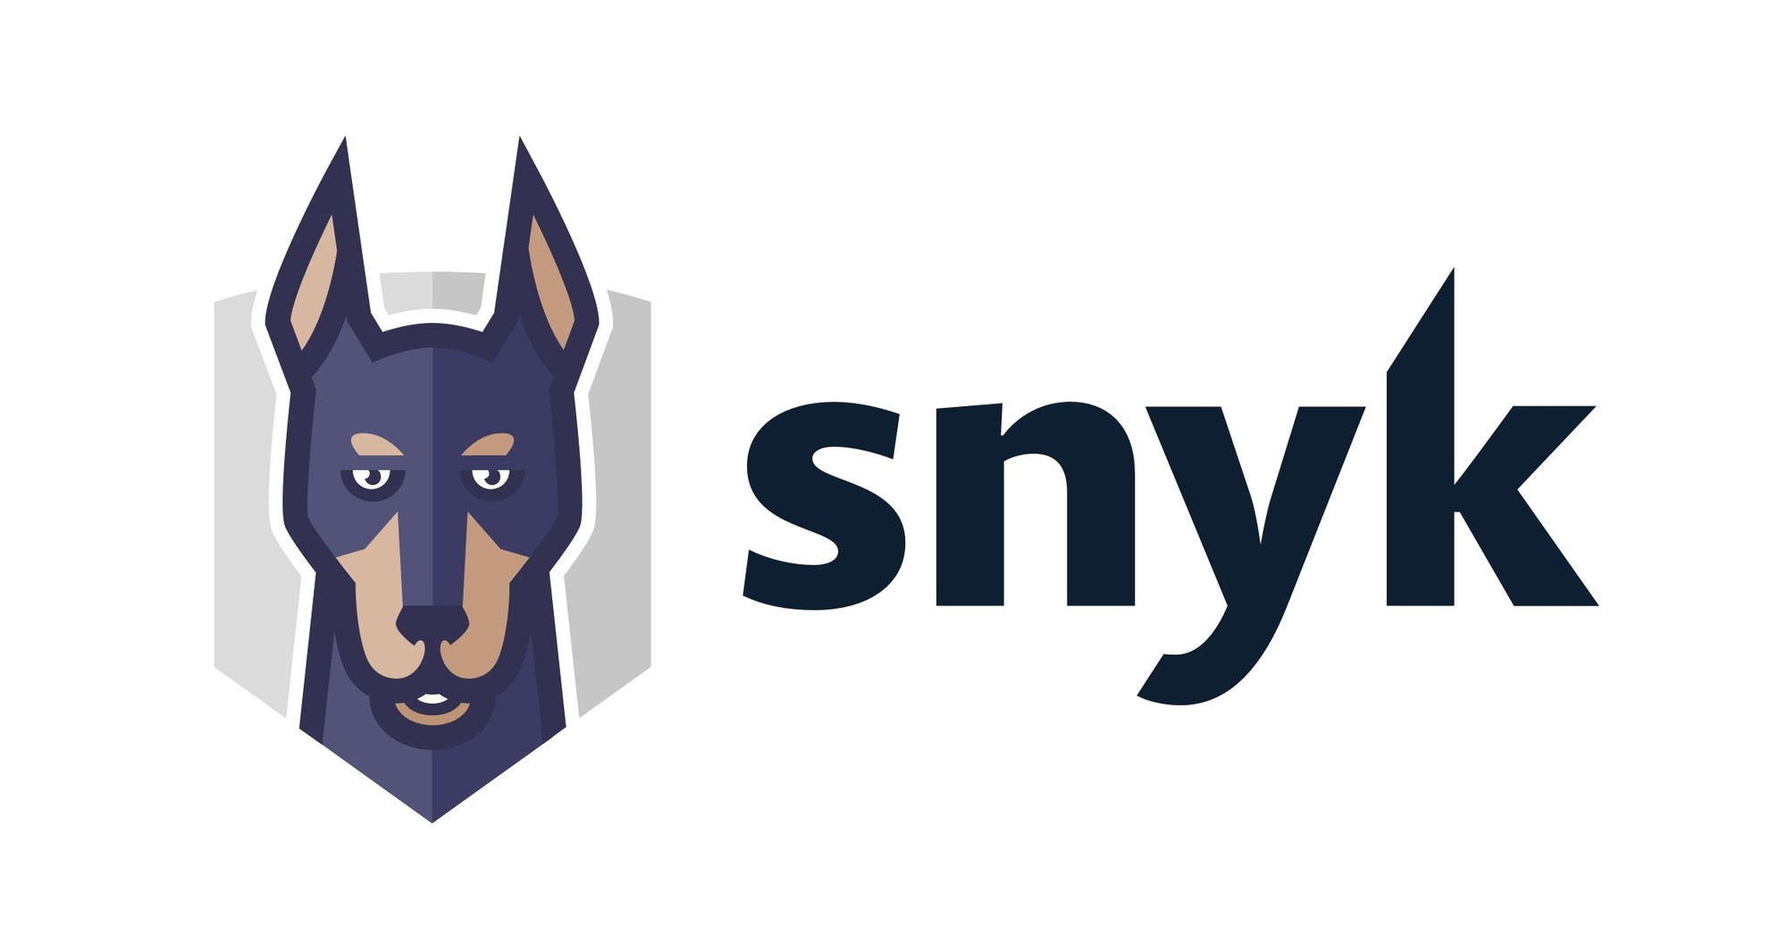

Vikas Vashisth (Software Consultant – DevOps at NashTech.)

Slide 2
KnolX Etiquettes
Lack of etiquette and manners is a huge turn off.
Punctuality
Join the session 5 minutes prior to the session start time. We start on time and conclude on time!
Feedback
Make sure to submit a constructive feedback for all sessions as it is very helpful for the presenter.
Silent Mode
Keep your mobile devices in silent mode, feel free to move out of session in case you need to attend an urgent call.
Avoid Disturbance
Avoid unwanted chit chat during the session.

Slide 3
Introduction to Snyk
Use Case
Pros and Cons
Comparison
Market Value
Installation & Demo

Slide 4
Introduction to Snyk

Slide 5
Snyk is a platform that scans, fixes security, vulnerabilities and prioritize your code,
open source dependencies, container images and Infrastructure as a Code (IaC).
In basic terms, it works as a scanning tool (like an antivirus) which helps you to prevent
your code from unwanted vulnerabilities.
Snyk is a Boston-based cyber security company specializing in cloud computing and founded in 2015.
It integrates the open source code that runs inside a container which is deployed on IaC with technology like Kubernetes and Terraform. So that all these processes should be secured.
It Integrates the DevOps process so that it will be feasible to work with the developers with best practices and industry standards.
It directly integrates with IDE's and workflow with automation pipelines to add security.

Slide 6
Use Case

Slide 7
Snyk Open Source
Secure your Code
Secure your Container
Secure your Deployment

Slide 8
Pros and Cons

Slide 9
Pros
Identify and fix issues as they emerge
Reduce security debt over time
Scale and govern security processes
Comprehensive Vulnerability Detection
Continuous Monitoring
Container Image Scanning

Slide 10
Cons
Limited Language Support
Limited offline scanning
Dependency on External Service
Time-consuming scanning process
Overall, Snyk provides robust vulnerability detection and monitoring capabilities, aiding
developers in identifying and addressing security risks in their software dependencies.
However, it's important to consider the limitations and potential trade-offs when choosing
Snyk or any other security tool for your specific requirements

Slide 11
Comparison

Slide 12
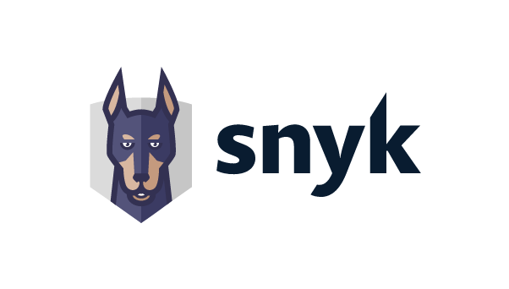
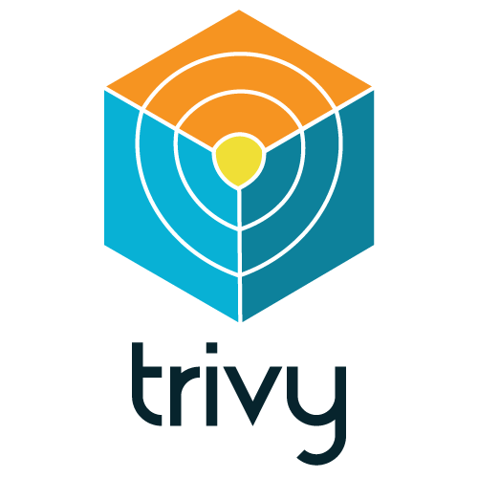
Features
Vulnerability Scanning | Comprehensive vulnerability scanning with extensive database coverage. | Focuses on scanning container images and package vulnerabilities in the OS layer.
Supported Ecosystems | Wide range of programming languages and open source ecosystems. | Primarily focused on container security, but also supports some programming languages.
Continuous Monitoring | Integrates with CI/CD pipelines for automated scanning throughout the development life cycle | Primarily designed for on-demand scanning rather than continuous monitoring.
Pricing | Offers free tier for individual developers and small projects, with pricing based on organization size and number of projects. | Open source and free to use, but lacks certain enterprise-grade features
User Interface & Reporting | User-friendly interface with clear reports, actionable insights, and collaboration features. | Primarily a command-line tool with basic reporting capabilities.
Support | Provides comprehensive support and documentation, including community support and enterprise-level support options. | Community-driven project with support available through forums and issue tracking on GitHub.

Slide 13
Market Value

Slide 14
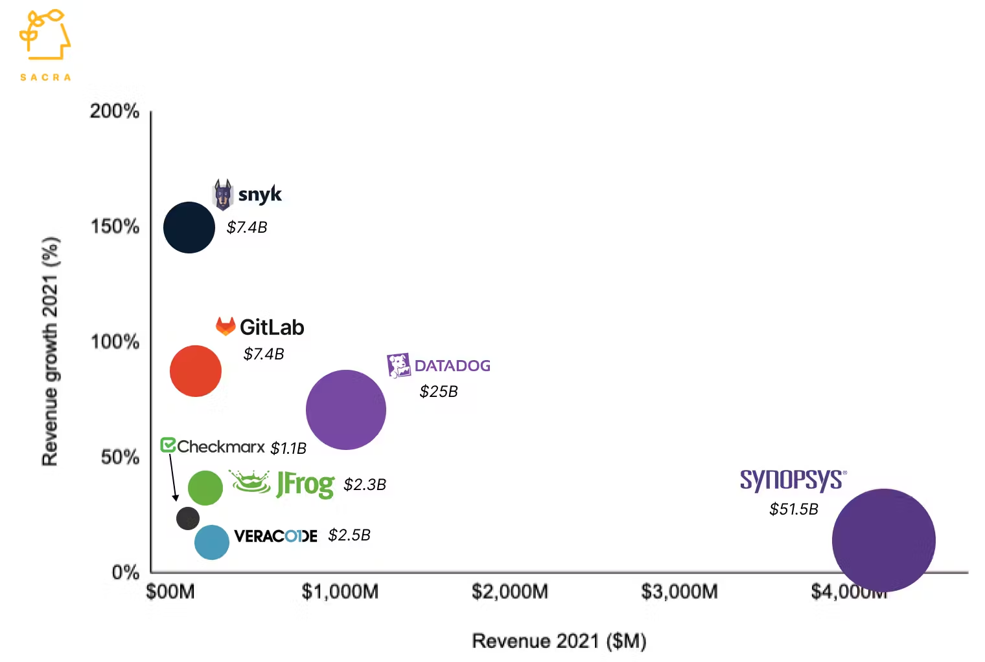

Slide 15
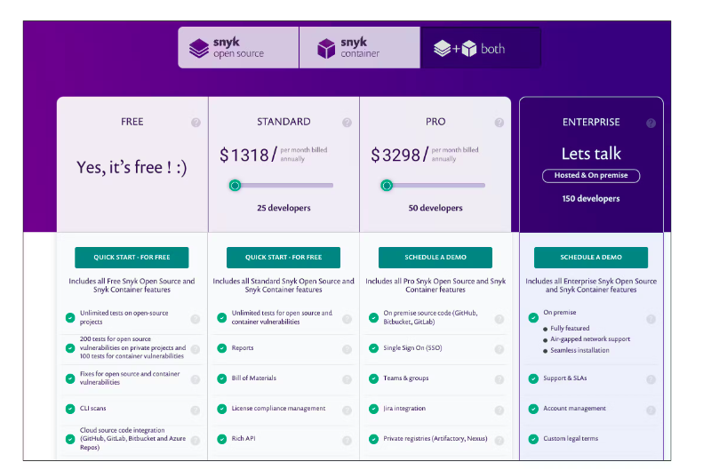
Pricing Model

Slide 16
Installation & Demo

Slide 17
Quiz time

Slide 18
Q1. Snyk is a ___________ company specializing in cloud computing and founded in ___.
Snyk is a Boston-based cyber security company specializing in cloud computing and founded in 2015.
Snyk is a Boston-based cyber security company specializing in cloud computing and founded in 2017.
Option A
Option B
Snyk is a America-based cyber security company specializing in cloud computing and founded in 2017.
Snyk is a America-based cyber security company specializing in cloud computing and founded in 2015.
Option C
Option D

Slide 19
Q1. Snyk is a ___________ company specializing in cloud computing and founded in ___.
Snyk is a Boston-based cyber security company specializing in cloud computing and founded in 2015.
Snyk is a Boston-based cyber security company specializing in cloud computing and founded in 2017.
Option A
Option B
Snyk is a America-based cyber security company specializing in cloud computing and founded in 2017.
Snyk is a America-based cyber security company specializing in cloud computing and founded in 2015.
Option C
Option D

Slide 20
Q2. Snyk offers how many types of plans ?
3 types of plan
2 types of plan
Option A
Option B
4 types of plan
5 types of plan
Option C
Option D

Slide 21
Q2. Snyk offers how many types of plans ?
3 types of plan
2 types of plan
Option A
Option B
4 types of plan
5 types of plan
Option C
Option D

Slide 22
Q3. Which pricing model does Snyk offer?
Pay-per-scan pricing
Pay-per-user pricing
Option A
Option B
Freemium with tiered plans
Customized pricing based on usage
Option C
Option D

Slide 23
Q3. Which pricing model does Snyk offer?
Pay-per-scan pricing
Pay-per-user pricing
Option A
Option B
Freemium with tiered plans
Customized pricing based on usage
Option C
Option D

